Slide 1
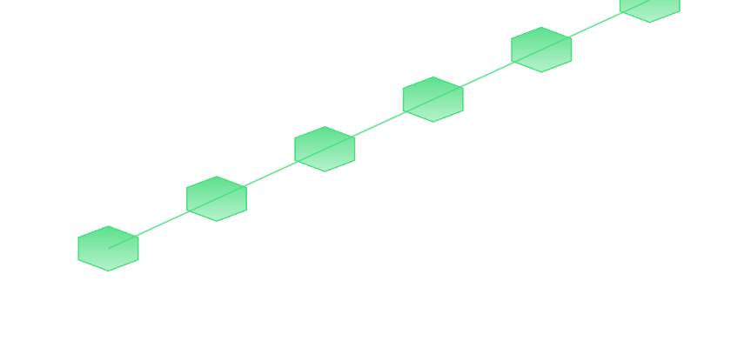
608,598 reviews
·
6 signal layers
·
0.944 AUC
FAKE REVIEW DETECTION
Fake Review Detection on Yelp.
Multi-Signal Analysis on YelpZip
Group 7 · CMPE 255 · Spring 2026
Himanshu Jain 019098794
Disha Jadav 018484362
REPOSITORY
Nitish Kumar 019155916
Dhruv Sachin Jain 019150859
github.com/dhruvj014/cmpe-255-01-group-7

Slide 2
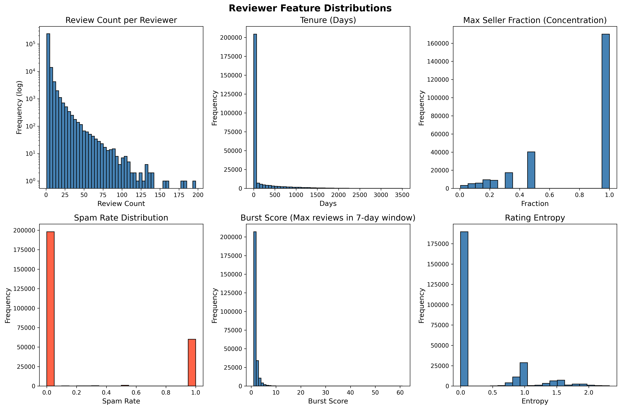
L1
·
ETL AND OLAP
PySpark ETL and Reviewer-Level EDA
14×
spam-rate gap, new (<30 days) vs veteran (>365 days) reviewers
PySpark ETL across 5 TSV files into review, reviewer, and seller feature tables
4 OLAP cubes; burst_score and rating_entropy highlight temporal and rating patterns
65% single-review users create bimodal spam_rate (0% or 100%), motivating L5 redesign
Reviewer feature distributions across 260,277 profiles, YelpZip.
The bimodal spam_rate distribution drives every downstream design choice.
Himanshu Jain

Slide 3
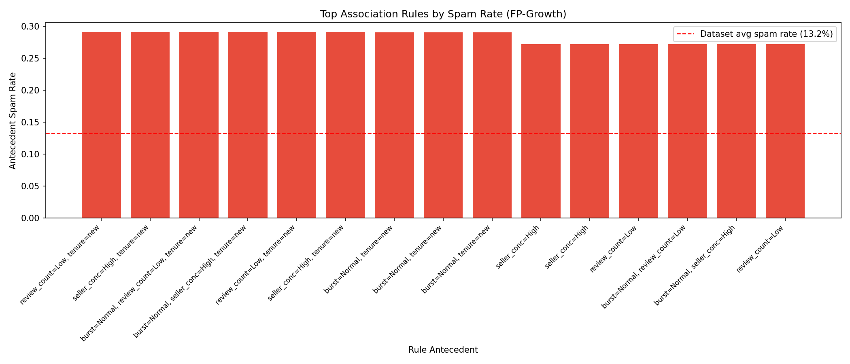
L2
·
FP-GROWTH ASSOCIATION RULES
FP-Growth Association Rule Mining on Discretized Reviewer Baskets
29.1%
spam rate for the dominant rule fingerprint, 2.2× baseline
260,277 reviewer baskets, 4 discretized features, 11 one-hot items
FP-Growth at min_support = 0.05 yields 35 itemsets, 24 spam-correlated rules
Top spam-correlated association rules vs. 13.2% baseline.
Hero antecedent: {tenure=new, count=Low, seller_conc=High} covers 73% of reviewers
FP-Growth surfaces the dominant spam fingerprint without hand-coded rules.
Dhruv Sachin Jain

Slide 4

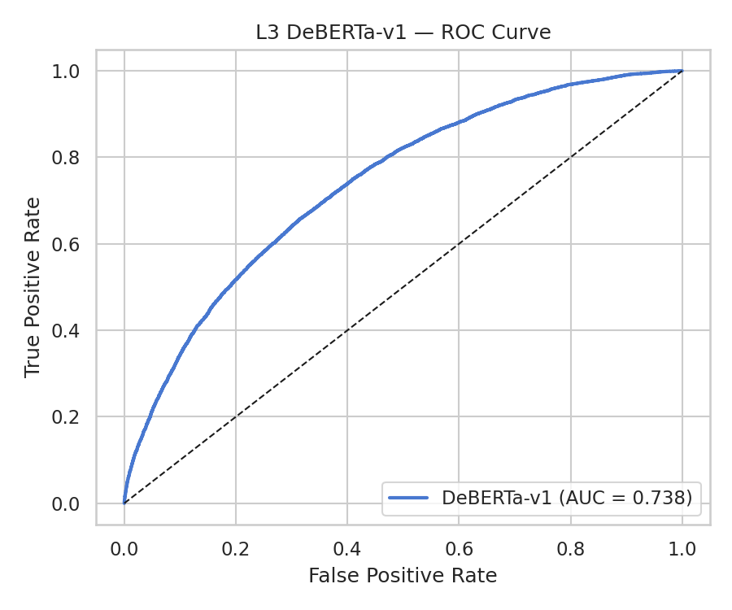
L3
·
DEBERTA TEXT CLASSIFICATION
Fine-Tuning DeBERTa-v3-base on Review Text
0.93
REVIEW TEXT
0.78
422K reviews · 99.8M params 6 epochs · AdamW lr 4e-5
→
"Best place ever!!!"
deberta_spam_prob
AUC-ROC on 53,687 held-out reviews
F1-macro 0.841 at threshold 0.425, tuned on val for class balance
Per-review deberta_spam_prob flows into Layer 5 as the 28th feature
Standalone text classifier already beats every behavioral signal on AUC
DeBERTa-v3-base ROC on 53,687 held-out reviews.
Text alone delivers 0.93 AUC and becomes Layer 5's most important feature.
Nitish Kumar

Slide 5
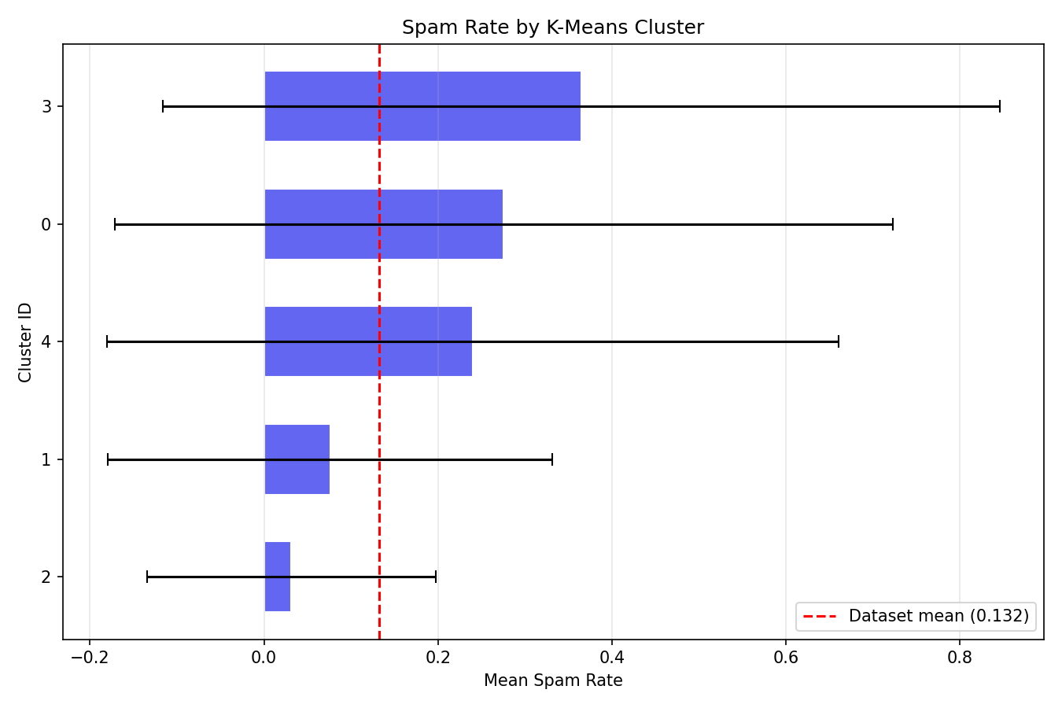
L4
·
K-MEANS AND DBSCAN CLUSTERING
K-Means and DBSCAN Reveal Dual Spam Modalities
27.6%
Cluster 0, 5-star fakes
36.5%
Cluster 3, 1-star attacks
K = 5 chosen by elbow method on inertia
Clusters 0 and 3 share behavioral profile but split by mean rating
DBSCAN cluster 13 (19,051 reviewers) reaches 47.7% spam, 3.6× baseline
Spam rate by K-Means cluster. Clusters 0 and 3 carry the bulk of spam.
Same behavioral shell, opposite intent: promotion vs. attack.
Dhruv Sachin Jain

Slide 6

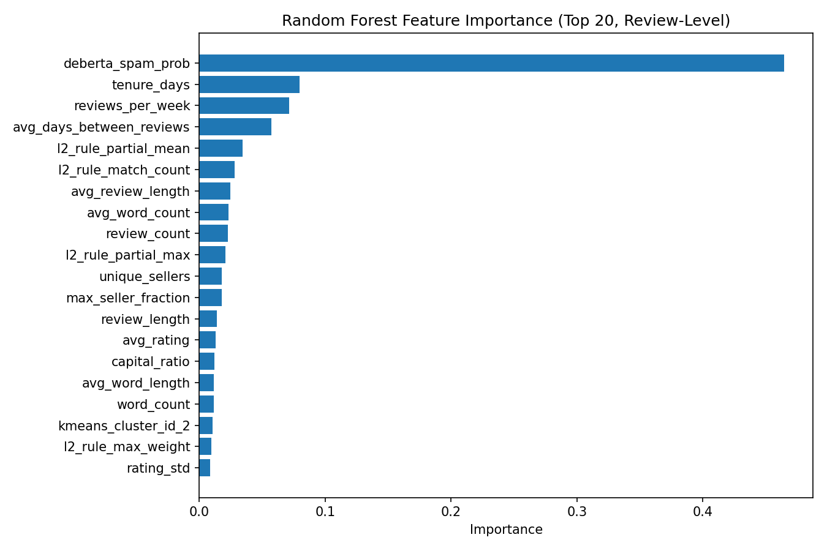
L5
·
CLASSIFICATION, FUSION, CALIBRATION
Multi-Signal Classification, Stacked Ensemble, Calibration
0.683 → 0.944
BEFORE
AFTER
Behavioral only
Multi-signal
MLP AUC across the project lifetime
AUC
0.819
AUC
0.944
0.003 → 0.741
F1
0.437
+ L3 deberta_spam_prob
F1
0.741
AP
0.368
AP
0.807
MLP F1@opt across the project lifetime
Stacked ensemble AUC 0.936
Isotonic ECE 0.011 → 0.003
Granularity redesign (reviewer to review level) plus L3 text fusion
MLP, Random Forest, Decision Tree all exceed AUC 0.93 post-fusion
Isotonic calibration drops Expected Calibration Error to 0.003
Granularity fix and text fusion convert the model from broken to publishable.
Disha Jadav

Slide 7
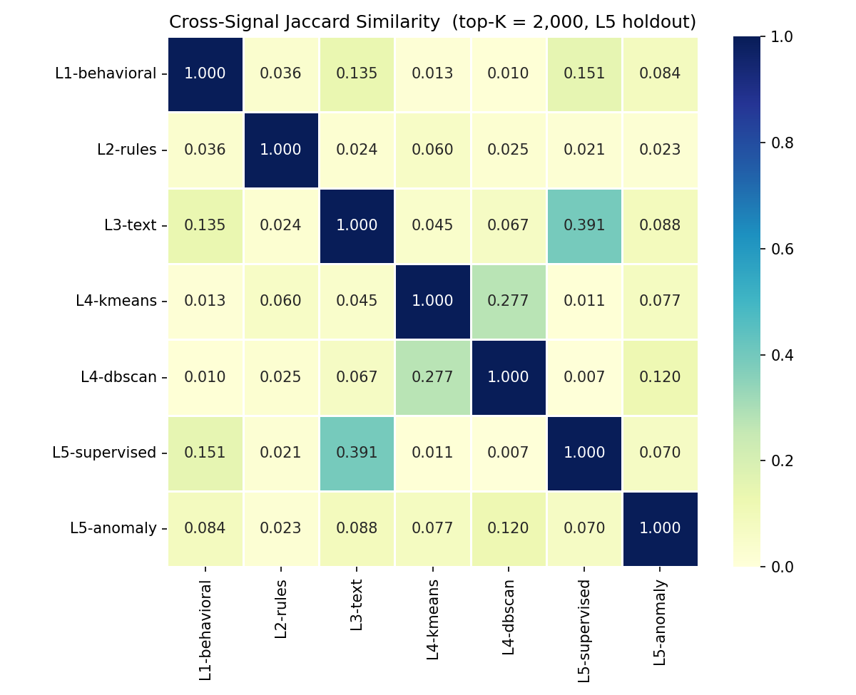
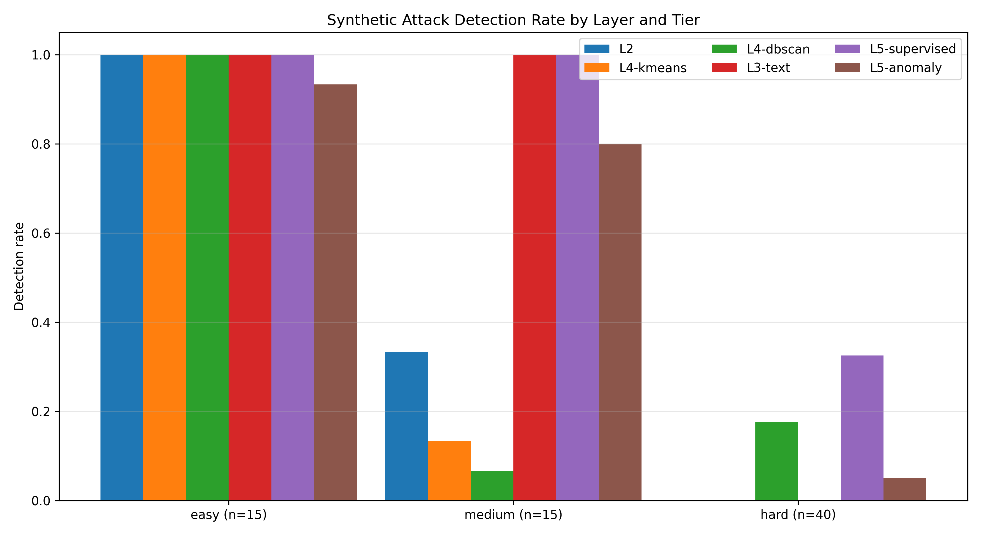
L6
·
ROBUSTNESS VALIDATION
Robustness via Synthetic Attacks and Cross-Signal Jaccard
33%
hard-tier camouflage caught by L5 fusion alone
JACCARD OVERLAP
0% caught by any single behavioral signal
70 synthetic attackers across easy, medium, hard tiers
L3-text alone solves the medium tier at 100%; behavioral signals reach 7 to 13%
Cross-signal Jaccard as low as 0.007 confirms complementary signals
Synthetic attack detection by layer; Jaccard overlap inset.
Hard-tier veterans evade behavior and text individually; only fused L5 catches them.
Himanshu Jain

